Slide 1

ETF/ Index ‘Best Ideas’ Investing
BIG PICTURE IDEA
Idea is to Invest in Growth stocks with the strongest fundamentals.
Over time, stocks with strongest fundamentals will provide significant alpha compared to rest of index.

Slide 2
Current Version (Minimum Viable Product - Alpha version 0.0.1)
Using Yahoo Finance API (pick an ETF - to tether your portfolio to an Index/Idea
Use Fundamental metrics (such as Revenue Growth and Current Ratio) combined with Market Metrics (such as Shares Short) to arrive at which names within the ETF/Index are bound to be a good Long Term Investment (1+ Year).
Limitations of Current version (v0.0.1)
Yahoo Finance API only allows us to view top10 holdings – in further iterations, we will explore other APIs, such as Alpaca or ETFDB to access all holdings for a more thorough sreening of ETF holdings.
Upon scrubbing the top10 names, we would have to manually allocate $10,000 to top 3 names – in future iterations, will be automate the number of ways we can allocate (and/ or re-balance) the portfolio – once a year – using KMeans and Monte Carlo Simulations.
Limited Metrics (Fundamental and Market) are being used in the current version - in future iterations, we will expand the metric to be much more extensive.
For Illustration, I have used Ticker: IJR (iShares Core S&P Small-Cap ETF)

Slide 3
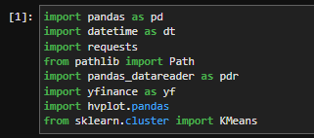
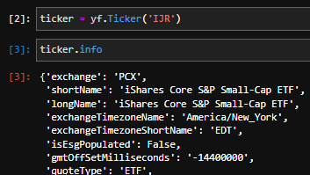
Steps
Step 1: Import applicable libraries
Step2: Connect to specific Ticker within yFinance API.

